Slide 1
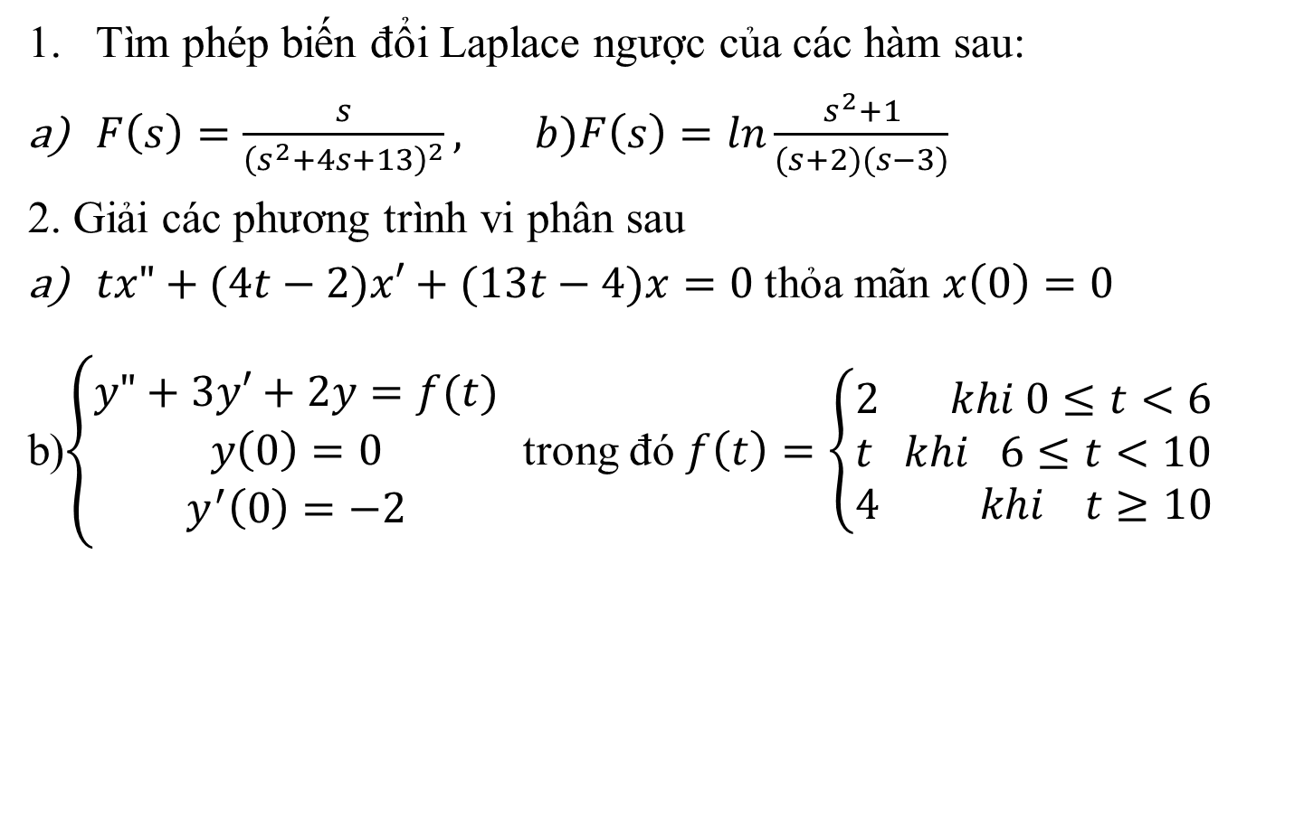
Một số VD
Tìm phép biến đổi Laplace ngược của các hàm sau:
$F\left(s\right)=\frac{s}{{\left(s^{2}+4s+13\right)}^{2}}, b)F\left(s\right)=ln\frac{s^{2}+1}{(s+2)(s−3)}$
2. Giải các phương trình vi phân sau
$tx"+(4t−2)x′+(13t−4)x=0$ thỏa mãn $x\left(0\right)=0$
b)$\left\{\begin{matrix}y"+3y′+2y=f(t) \\ y\left(0\right)=0 \\ y^{′}\left(0\right)=−2\end{matrix}\right.$ trong đó $f\left(t\right)=\left\{\begin{matrix}2 khi 0≤t<6 \\ t khi 6≤t<10 \\ 4 khi t≥10\end{matrix}\right.$

Slide 2
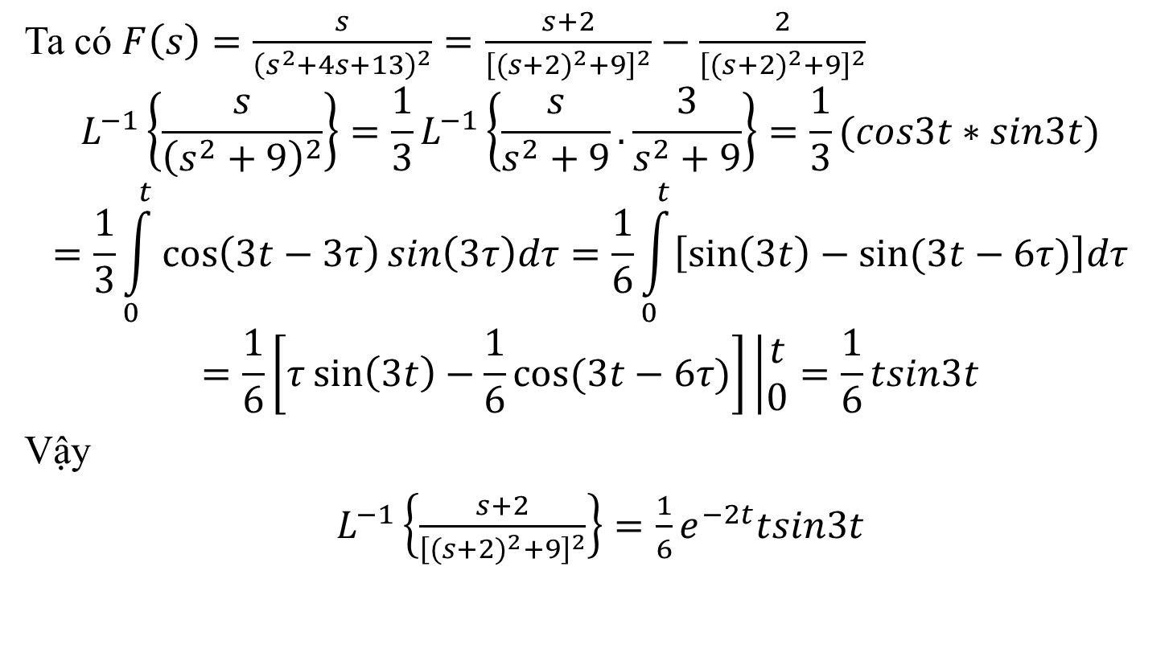

1.a Tìm phép biến đổi Laplace ngược $F\left(s\right)=\frac{s}{{\left(s^{2}+4s+13\right)}^{2}}$
Ta có $F\left(s\right)=\frac{s}{{\left(s^{2}+4s+13\right)}^{2}}=\frac{s+2}{{\left[{(s+2)}^{2}+9\right]}^{2}}−\frac{2}{{\left[{(s+2)}^{2}+9\right]}^{2}}$
$$L^{−1}\left\{\frac{s}{{\left(s^{2}+9\right)}^{2}}\right\}={\frac{1}{3}L}^{−1}\left\{\frac{s}{s^{2}+9}.\frac{3}{s^{2}+9}\right\}=\frac{1}{3}(cos3t∗sin3t)$$
$$=\frac{1}{3}\int_{0}^{t}{\cos\left(3t−3τ\right)sin\left(3τ\right)dτ=\frac{1}{6}\int_{0}^{t}{\left[\sin\left(3t\right)−sin⁡(3t−6τ)\right]dτ}}$$
$$=\frac{1}{6}\left[τ\sin\left(3t\right)−\frac{1}{6}cos⁡(3t−6τ)\right]\left|\begin{matrix}t \\ 0\end{matrix}=\frac{1}{6}tsin3t\right.$$
Vậy
$L^{−1}\left\{\frac{s+2}{{\left[{(s+2)}^{2}+9\right]}^{2}}\right\}={\frac{1}{6}e}^{−2t}tsin3t$

Slide 3
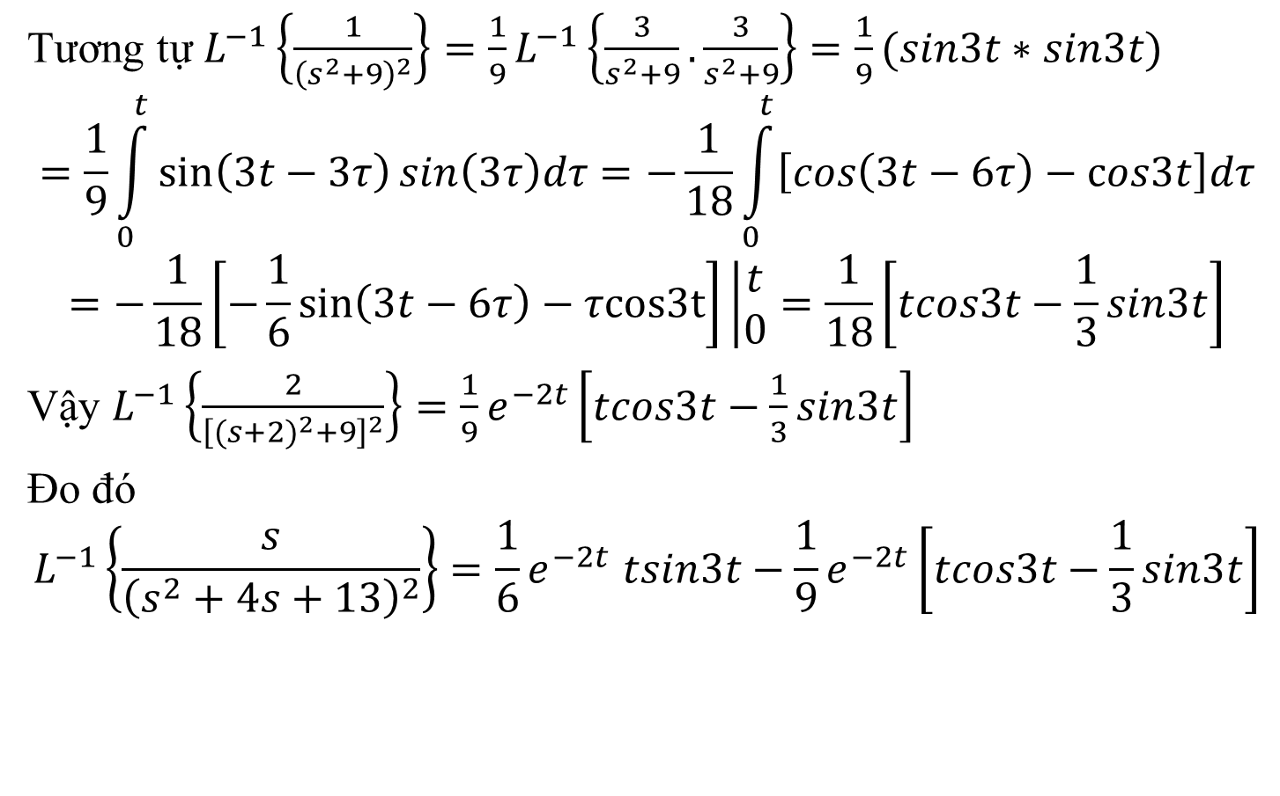
Câu 1.a (tiếp)
Tương tự $L^{−1}\left\{\frac{1}{{\left(s^{2}+9\right)}^{2}}\right\}={\frac{1}{9}L}^{−1}\left\{\frac{3}{s^{2}+9}.\frac{3}{s^{2}+9}\right\}=\frac{1}{9}(sin3t∗sin3t)$
$$=\frac{1}{9}\int_{0}^{t}{\sin\left(3t−3τ\right)sin\left(3τ\right)dτ=−\frac{1}{18}\int_{0}^{t}{\left[\cos\left(3t−6τ\right)−cos3t\right]dτ}}$$
$$=−\frac{1}{18}\left[−\frac{1}{6}\sin\left(3t−6τ\right)−τcos3t\right]\left|\begin{matrix}t \\ 0\end{matrix}=\frac{1}{18}\left[tcos3t−\frac{1}{3}sin3t\right]\right.$$
Vậy $L^{−1}\left\{\frac{2}{{\left[{(s+2)}^{2}+9\right]}^{2}}\right\}=\frac{1}{9}e^{−2t}\left[tcos3t−\frac{1}{3}sin3t\right]$
Đo đó
$$L^{−1}\left\{\frac{s}{{\left(s^{2}+4s+13\right)}^{2}}\right\}{=\frac{1}{6}e}^{−2t}tsin3t−\frac{1}{9}e^{−2t}\left[tcos3t−\frac{1}{3}sin3t\right]$$

Slide 4
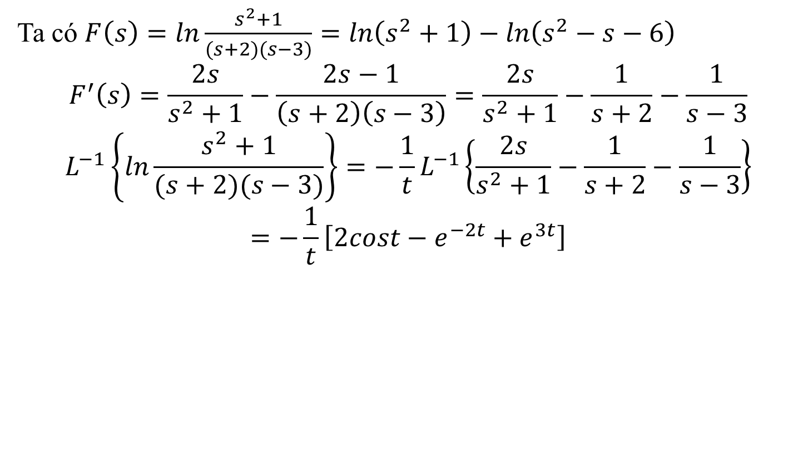

Câu 1.b Tìm phép biến đổi Laplace ngược của $$F\left(s\right)=ln\frac{s^{2}+1}{(s+2)(s−3)}$$
Ta có $F\left(s\right)=ln\frac{s^{2}+1}{(s+2)(s−3)}=ln\left(s^{2}+1\right)−ln\left(s^{2}−s−6\right)$
$$F^{′}\left(s\right)=\frac{2s}{s^{2}+1}−\frac{2s−1}{\left(s+2\right)\left(s−3\right)}=\frac{2s}{s^{2}+1}−\frac{1}{s+2}−\frac{1}{s−3}$$
$$L^{−1}\left\{ln\frac{s^{2}+1}{(s+2)(s−3)}\right\}=−\frac{1}{t}L^{−1}\left\{\frac{2s}{s^{2}+1}−\frac{1}{s+2}−\frac{1}{s−3}\right\}$$
$$=−\frac{1}{t}\left[2cost−e^{−2t}+e^{3t}\right]$$

Slide 5
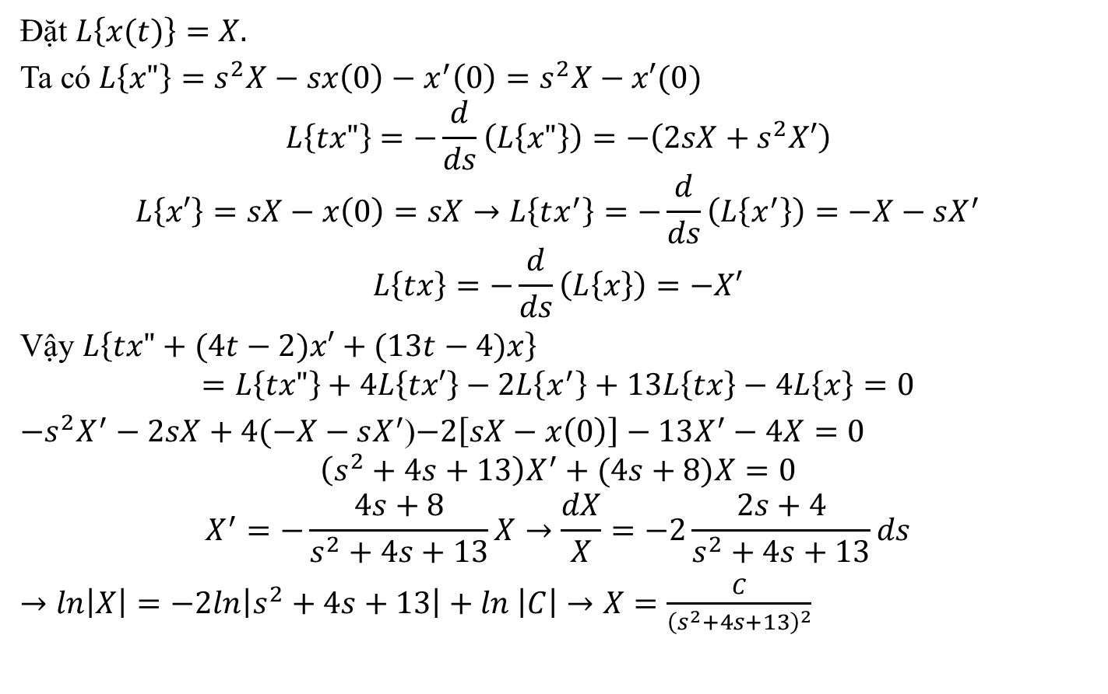

2.a$tx"+(4t−2)x′+(13t−4)x=0$ thỏa mãn $x\left(0\right)=0$
Đặt $L\left\{x(t)\right\}=X.$
Ta có $L\left\{x"\right\}=s^{2}X−sx\left(0\right)−x^{′}\left(0\right)=s^{2}X−x′(0)$
$$L\left\{tx"\right\}=−\frac{d}{ds}\left(L\left\{x"\right\}\right)=−\left(2sX+s^{2}X′\right)$$
$$L\left\{x′\right\}=sX−x\left(0\right)=sX→L\left\{tx^{′}\right\}=−\frac{d}{ds}\left(L\left\{x^{′}\right\}\right)=−X−sX^{′}$$
$$L\left\{tx\right\}=−\frac{d}{ds}\left(L\left\{x\right\}\right)=−X′$$
Vậy $L\left\{tx"+(4t−2)x′+(13t−4)x\right\}$
$$=L\left\{tx"\right\}+4L\left\{tx′\right\}−2L\left\{x^{′}\right\}+13L\left\{tx\right\}−4L\left\{x\right\}=0$$
${−s}^{2}X^{′}−2sX+4(−X−sX^{′}$)$−2\left[sX−x\left(0\right)\right]−13X^{′}−4X=0$
$$\left(s^{2}+4s+13\right)X^{′}+(4s+8)X=0$$
$$X^{′}=−\frac{4s+8}{s^{2}+4s+13}X→\frac{dX}{X}=−2\frac{2s+4}{s^{2}+4s+13}ds$$
$→ln\left|X\right|=−2ln\left|s^{2}+4s+13\right|+ln$ $\left|C\right|→X=\frac{C}{{\left(s^{2}+4s+13\right)}^{2}}$

Slide 6
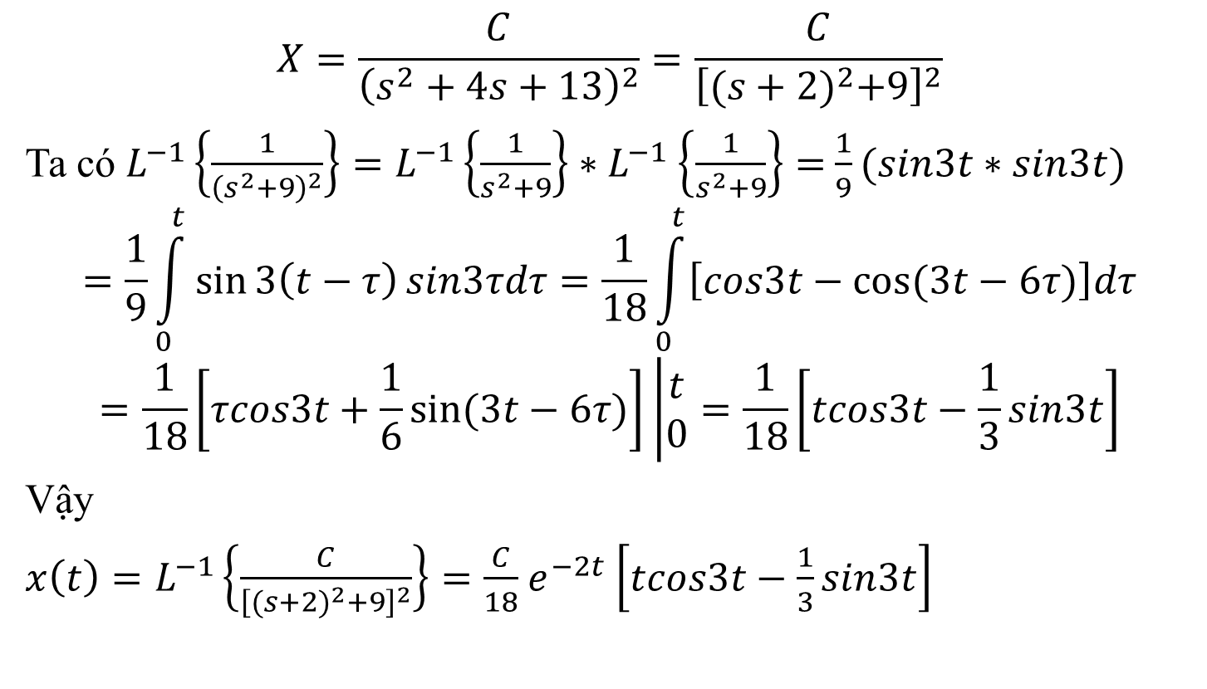
Bài 2.a (tiếp)
$$X=\frac{C}{{\left(s^{2}+4s+13\right)}^{2}}=\frac{C}{{\left[{(s+2)}^{2}+9\right]}^{2}}$$
Ta có $L^{−1}\left\{\frac{1}{{\left(s^{2}+9\right)}^{2}}\right\}=L^{−1}\left\{\frac{1}{s^{2}+9}\right\}{∗L}^{−1}\left\{\frac{1}{s^{2}+9}\right\}=$ $\frac{1}{9}(sin3t∗sin3t)$
$$=\frac{1}{9}\int_{0}^{t}{\sin{3\left(t−τ\right)}sin3τdτ=\frac{1}{18}\int_{0}^{t}{\left[cos3t−cos⁡(3t−6τ)\right]dτ}}$$
$$=\frac{1}{18}\left[τcos3t+\frac{1}{6}sin⁡(3t−6τ)\right]\left|\begin{matrix}t \\ 0\end{matrix}=\frac{1}{18}\right.\left[tcos3t−\frac{1}{3}sin3t\right]$$
Vậy
$x\left(t\right)=L^{−1}\left\{\frac{C}{{\left[{(s+2)}^{2}+9\right]}^{2}}\right\}=\frac{C}{18}$ $e^{−2t}$ $\left[tcos3t−\frac{1}{3}sin3t\right]$

Slide 7
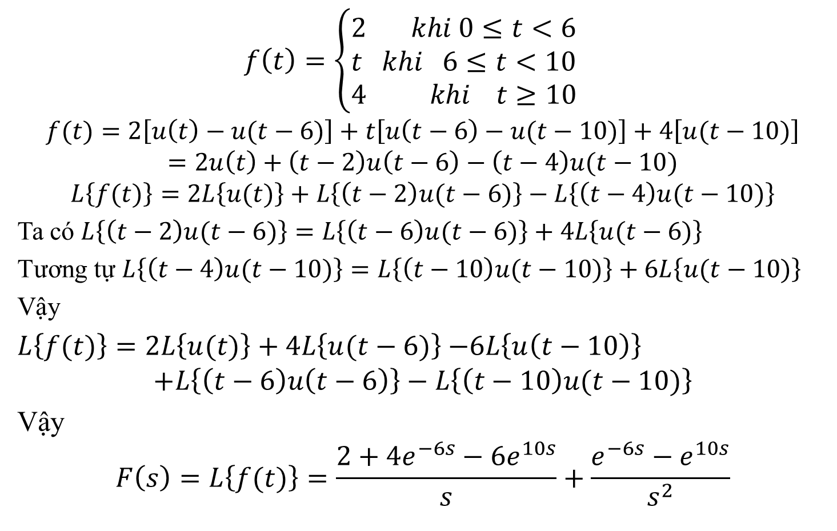
Bài 2.b
$$f\left(t\right)=\left\{\begin{matrix}2 khi 0≤t<6 \\ t khi 6≤t<10 \\ 4 khi t≥10\end{matrix}\right.$$
$$f(t)=2\left[u\left(t\right)−u(t−6)\right]+t\left[u\left(t−6\right)−u(t−10)\right]+4\left[u(t−10)\right]$$
$$=2u\left(t\right)+\left(t−2\right)u\left(t−6\right)−\left(t−4\right)u(t−10)$$
$$L\left\{f(t)\right\}=2L\left\{u(t)\right\}+L\left\{\left(t−2\right)u(t−6)\right\}−L\left\{\left(t−4\right)u(t−10)\right\}$$
Ta có $L\left\{\left(t−2\right)u(t−6)\right\}=L\left\{\left(t−6\right)u(t−6)\right\}+4L\left\{u(t−6)\right\}$
Tương tự $L\left\{\left(t−4\right)u(t−10)\right\}=L\left\{\left(t−10\right)u(t−10)\right\}+6L\left\{u(t−10)\right\}$
Vậy
$L\left\{f(t)\right\}=2L\left\{u(t)\right\}+$ $4L\left\{u(t−6)\right\}$ $−6L\left\{u\left(t−10\right)\right\}$
$$+L\left\{\left(t−6\right)u\left(t−6\right)\right\}−L\left\{\left(t−10\right)u(t−10)\right\}$$
Vậy
$$F\left(s\right)=L\left\{f(t)\right\}=\frac{2+4e^{−6s}−6e^{10s}}{s}+\frac{e^{−6s}−e^{10s}}{s^{2}}$$

Slide 8
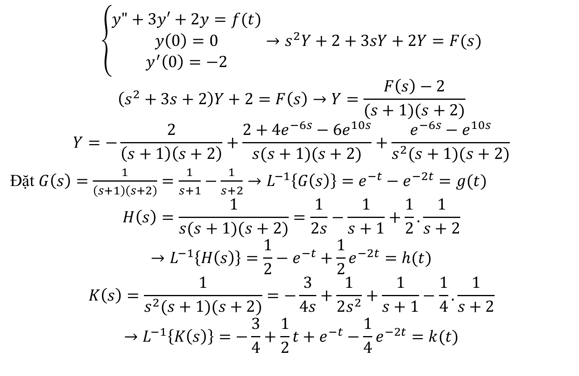
Bài 2b. (tiếp)
$$\left\{\begin{matrix}y"+3y′+2y=f(t) \\ y\left(0\right)=0 \\ y^{′}\left(0\right)=−2\end{matrix}\right.→s^{2}Y+2+3sY+2Y=F(s)$$
$$\left(s^{2}+3s+2\right)Y+2=F\left(s\right)→Y=\frac{F\left(s\right)−2}{(s+1)(s+2)}$$
$$Y=−\frac{2}{\left(s+1\right)\left(s+2\right)}+\frac{2+4e^{−6s}−6e^{10s}}{s(s+1)(s+2)}+\frac{e^{−6s}−e^{10s}}{s^{2}(s+1)(s+2)}$$
Đặt $G\left(s\right)=$ $\frac{1}{\left(s+1\right)\left(s+2\right)}=\frac{1}{s+1}−\frac{1}{s+2}→L^{−1}\left\{G\left(s\right)\right\}=e^{−t}−e^{−2t}=g(t)$
$$H\left(s\right)=\frac{1}{s(s+1)(s+2)}=\frac{1}{2s}−\frac{1}{s+1}+\frac{1}{2}.\frac{1}{s+2}$$
$$→L^{−1}\left\{H\left(s\right)\right\}=\frac{1}{2}−e^{−t}+\frac{1}{2}e^{−2t}=h(t)$$
$$K\left(s\right)=\frac{1}{s^{2}(s+1)(s+2)}=−\frac{3}{4s}+\frac{1}{2s^{2}}+\frac{1}{s+1}−\frac{1}{4}.\frac{1}{s+2}$$
$$→L^{−1}\left\{K\left(s\right)\right\}=−\frac{3}{4}+\frac{1}{2}t+e^{−t}−\frac{1}{4}e^{−2t}=k(t)$$

Slide 9

Bài 2b. (tiếp)
Vậy $y\left(t\right)=−2g\left(t\right)+2h\left(t\right)+4h\left(t−6\right)u\left(t−6\right)$
$$−6h\left(t−10\right)u\left(t−10\right)+k\left(t−6\right)u\left(t−6\right)−k\left(t−10\right)u\left(t−10\right)$$
$$=−2g\left(t\right)+2h\left(t\right)+\left[4h\left(t−6\right)+k\left(t−6\right)\right]u\left(t−6\right)$$
$$−\left[6h\left(t−10\right)+k9t−10)\right]u\left(t−10\right).$$

